Slide 1
Sports Analytics
Project Presentation
Presenter - Arusyak Hakobyan
Instructor - Habet Madoyan

Slide 2

National Hockey League
Professional ice hockey league in North America
Comprising 31 teams:
24 - United States
7 - Canada.

Slide 3
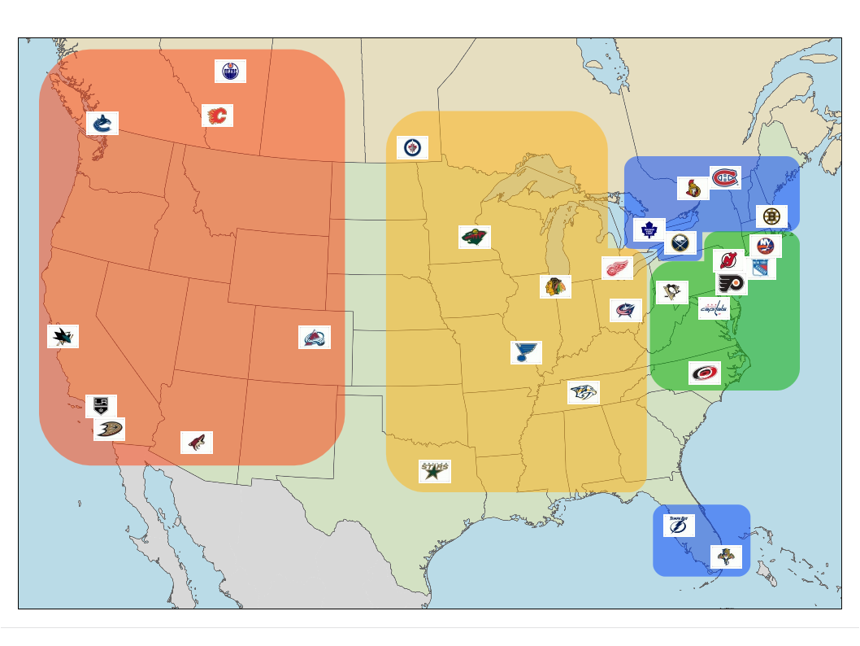
Data and Sorting
2017 - 2018 Season Data
NHL Team Division
Atlantic
Central
Pacific
Metropolitan

Slide 4
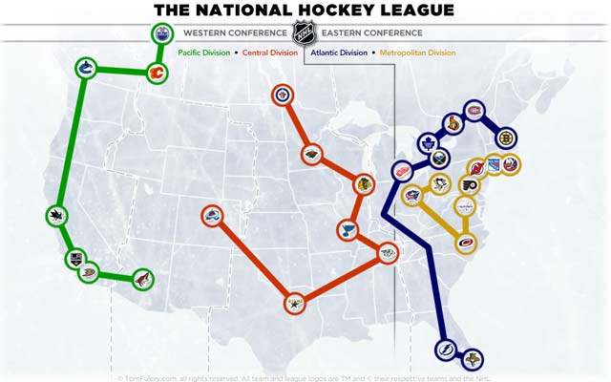

Slide 5
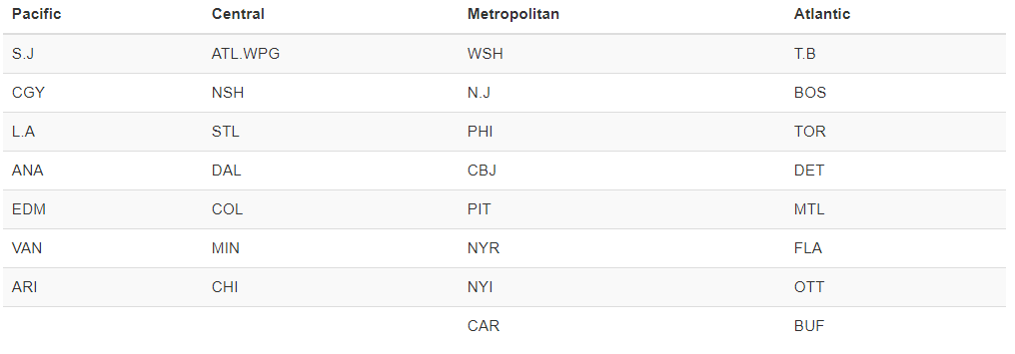

Slide 6
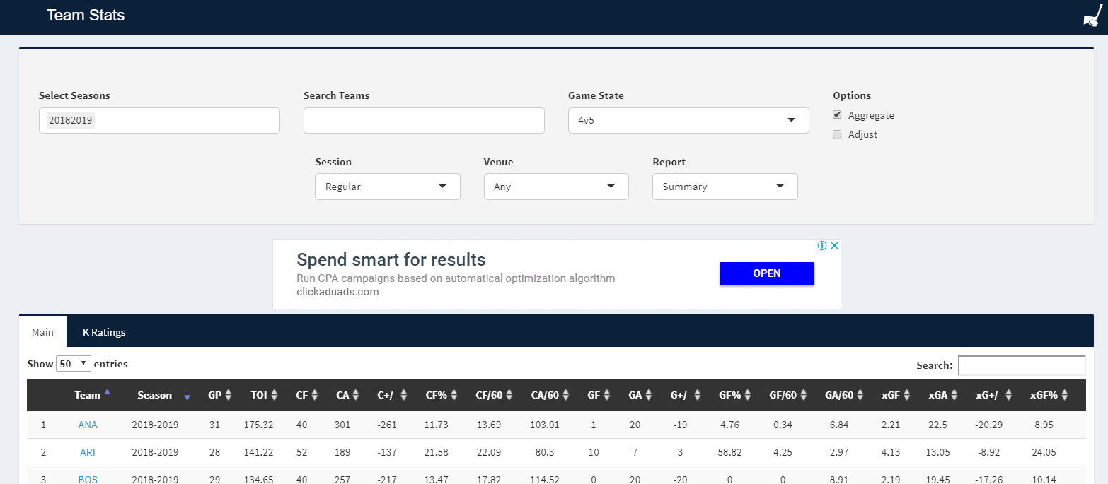
Data retrieved from Corsica

Slide 7
How much is powerplay advantageous in NHL?

Slide 8
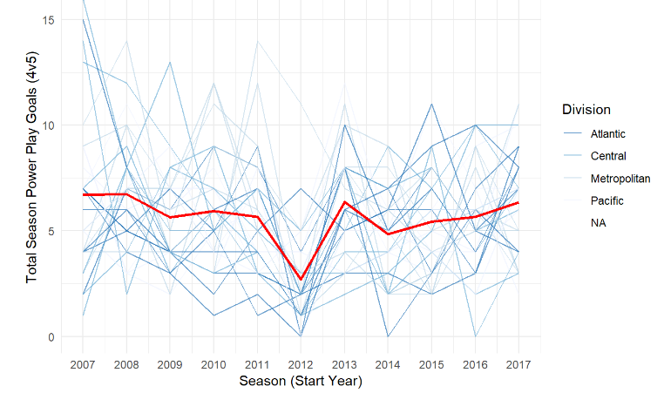
Is the amount of power play goals changing over time ?

Slide 9
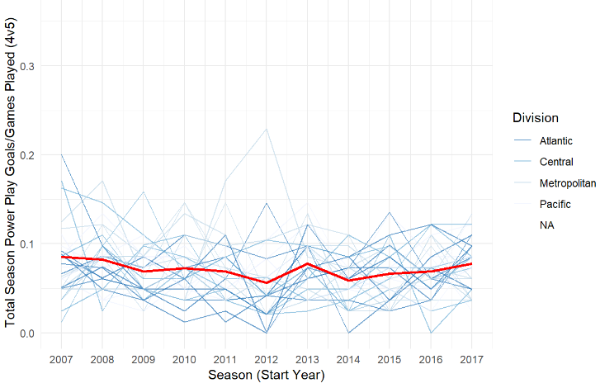
When shortened season controlled?

Slide 10
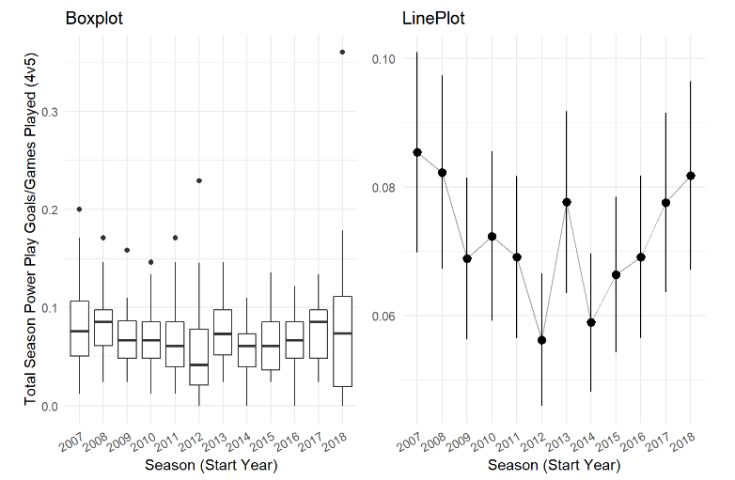

Slide 11
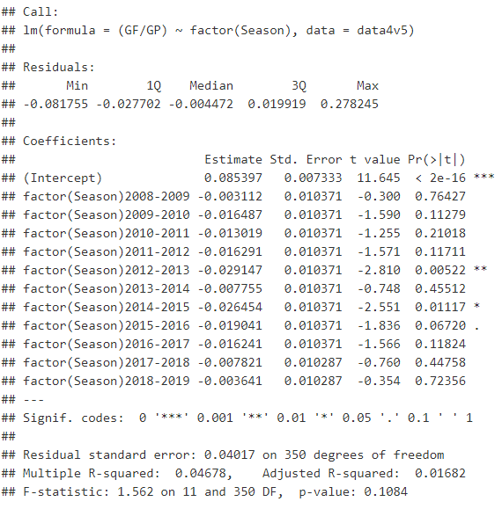

Slide 12
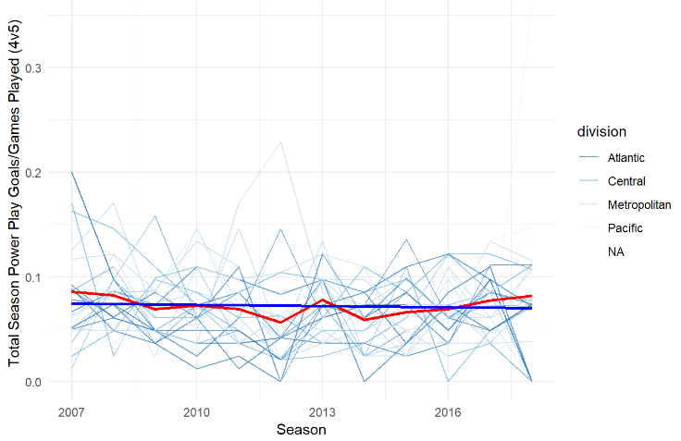
Linear Trend for 4vs5 power play

Slide 13
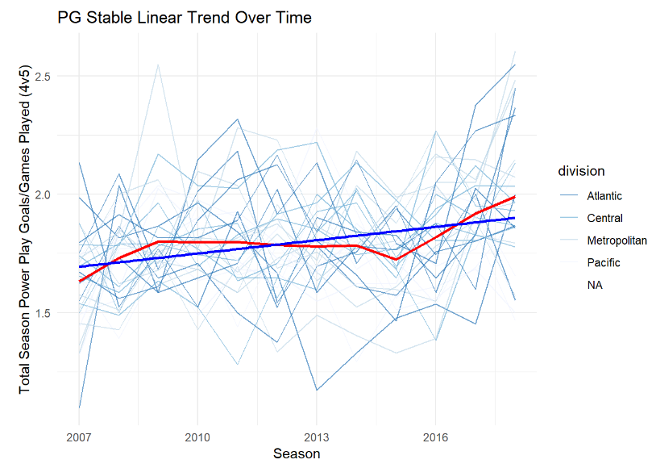
Linear Trend for 5vs5 power play

Slide 14
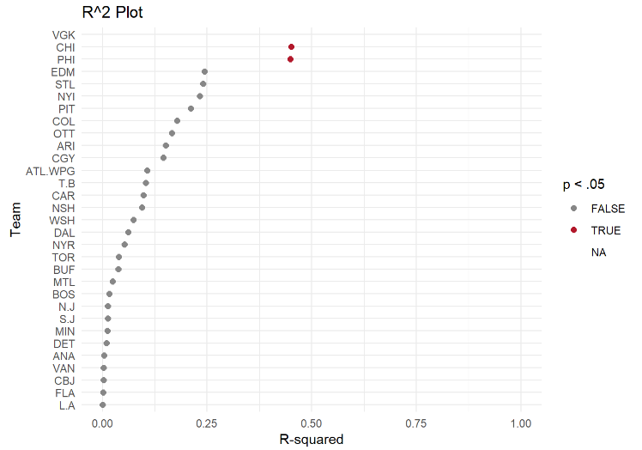

Slide 15
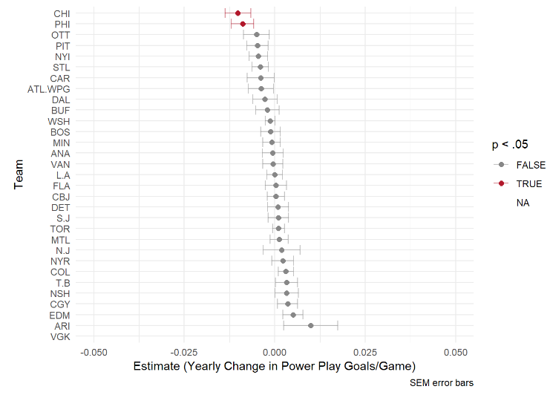

Slide 16

Conclusion...

Slide 17

Thanks!
Any questions?

